Slide 1
Information System Design
Information System Design Methodologies
Information System Design

Slide 2
Software Design Process
Architectural styles
SRS
Design methodologies
Architectural design
Architecture
Algorithmic specification
Physical design
Structure
Coding
Detailed design
Algorithms

Slide 3
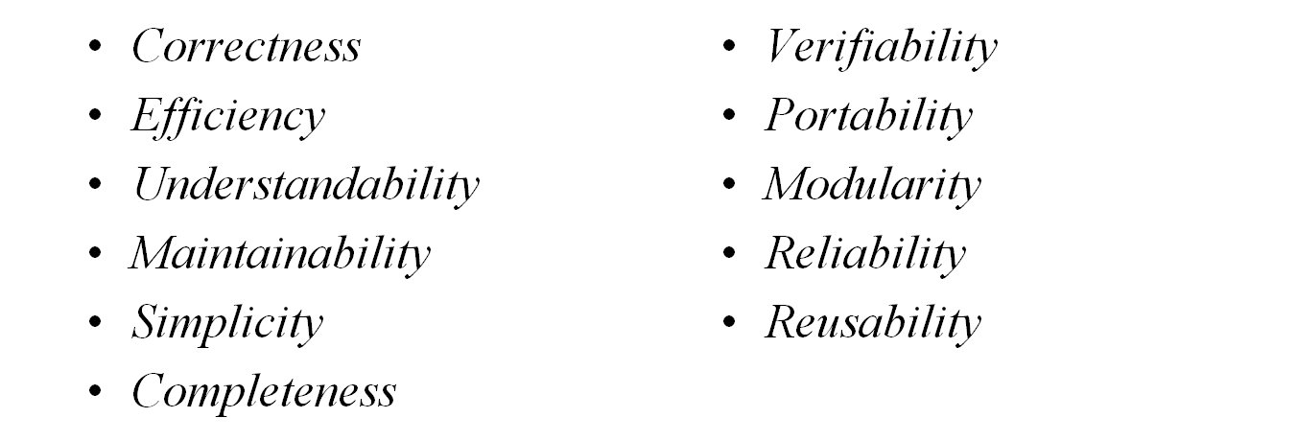
Characteristics of a Good Software Design
The desirable characteristics that a good software design should have are as follows:

Slide 4
Design Principles
There are certain design concepts and principles that govern the building of quality software designs.
Some of the common concepts of software design are:
  Abstraction
  information hiding
  functional decomposition
  design strategies
  Modularity
  and modular design

Slide 5
Design Principles
Abstraction
The process of describing a problem at a higher level of representation without bothering about its internal details.
Problem partitioning and abstraction are closely related in a software design.
There are two levels of abstraction
    high-level abstraction
    low-level abstraction
Software engineering practitioners think software development is the movement in different levels of abstraction.
There are three types of abstraction, namely, functional abstraction, data abstraction, and control abstraction.

Slide 6
Design Principles
Information Hiding
Information hiding is an important design principle which is expressed through encapsulation and abstraction.
It helps in modularization of software projects into small components.
It allows the programmers to change the implementation of the application for better performance.

Slide 7
Design Principles
Functional Decomposition
WordPad
File
creation
Saving
Editing
Printing
Formatting
Setting
Save as
Save
Color
Font
Tab
Paragraph
Figure 6.2: Functional decomposition of WordPad

Slide 8
Design Principles
Design Strategies: Top-down strategy
Main Problem
S 1
S 2
…
S n
S 1.1
S 1.2
S 2.1
S 2.2
S n.1
S n.m
Figure 6.3: Top-down strategy

Slide 9

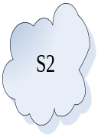




Design Principles
Design Strategies: Bottom-up strategy
…
A
B
C
S
Figure 6.4: Bottom-up strategy

Slide 10
Design Principles
Modular Design
A modular design focuses on minimizing the interconnections between modules.
In a modular system design, several independent and executable modules are composed together to construct an executable application program.
The programming language support, interfaces, and the information-hiding principles ensure modular system design.
The most common criterions are functional independency; levels of abstraction; information hiding; functional diagrams, such as DFD, modular programming languages, coupling, and cohesion.
An effective modular system has low coupling and high cohesion.

Slide 11
Design Principles
Coupling
It is the strength of interconnection between modules. It is the measure of the degree of interdependency between modules.
Modules are either loosely coupled or strongly coupled.
In strong coupling, two modules are dependent on each other. Strong coupling can be observed in assembly language programs where change in one part or data requires changes in other parts of the system.
Also, these are difficult to reuse, test, and release for the operation.
In loose coupling, there are weak interconnections between modules.
Interdependency between modules increases as coupling increases.

Slide 12
Design Principles
Coupling
Interconnection between modules can be measured by the number of function calls, number of parameters passed, return values, data types, sharing of data files or data items, etc.
The strength of interconnection between modules is influenced by the level of complexity of the interfaces, type of connection, and the type of communication.
The complexity of an interface is the measure of the type of parameters, number of parameters, common sharing of data or code communicated by modules.
The connection between modules is established by relating one module to another through parts of the system or through certain data value.
Communication is the data passed, type of data, and the control information passed to another module.

Slide 13
Design Principles
Types of coupling:
  1. Message coupling Lowest (best)
  2. Data coupling
  3. Stamp coupling
  4. Control coupling
  5. External coupling
  6. Common coupling
  7. Content coupling Highest (worst)

Slide 14
Design Principles
Types of coupling
Message Coupling: Message coupling is the lowest (i.e. best) type of coupling which exists between modules. For example, in C++ objects communicate with each other by sending a message through parameters in the function call.
Data Coupling: Data coupling exists between modules when data are passed as parameters in the argument list of the function call. Each datum is a primary data item (e.g., integer, character, float, etc.) that can be used between modules.
Stamp Coupling: It occurs between modules when data are passed by parameters using complex data structures, which may use parts or the entire data structure by other modules. For example, structures in C, records in Pascal, etc.
Control Coupling: It exists when one module controls the flow of another by passing control information such as flag set or switch statements. For example, a flag variable decides what function or module is to be executed next.
External Coupling: External coupling occurs when two modules share an externally imposed data format, communication protocol, or device interface.
Common Coupling: Common coupling is when two modules share common data (e.g., a global variable). In C language, external data items are accessed by all modules in the program. If there is any change in the shared resource, it influences all the modules using it.
Content Coupling : It is the highest coupling (worst). Content coupling exists between two modules when one module refers or shares its internal working with another module. Accessing local data items or instructions of another module is an example of content coupling.

Slide 15
Design Principles
Cohesion:
Cohesion of a single module is the degree to which the elements of a single module are functionally related to achieve an objective.
Module cohesion represents how tightly bound the internal elements of the module are to one another.
High cohesion is often characterized by more understandability, modifiability, and maintainability of the modules in a system.
Low cohesive modules are highly undesirable and should be modified or replaced to meet the objectives of modular design.
The important goal of designers is to maximize cohesion and minimize coupling.
Cohesion between the elements of a module is measured in terms of the strength of the hiding of the elements within the module itself.
A functionally independent module has higher cohesion as compared to dependent modules.

Slide 16
Design Principles
Levels of cohesion:
  1. Functional cohesion Strongest (best)
  2. Sequential cohesion
  3. Communicational cohesion
  4. Procedural cohesion
  5. Temporal cohesion
  6. Logical cohesion
  7. Coincidental cohesion Weakest (worst)

Slide 17
Design Principles
Levels of cohesion
Functional Cohesion: In a functionally cohesive module, all the elements of the module perform a single function. For example, “log” computes the logarithm of a number and “printf” prints the results.
Sequential Cohesion: Sequential cohesion exists when the output from one element of a module becomes the input for some other element.. For example, “withdraw money” and “update balance” both are bound together to withdraw money from an account.
Communicational Cohesion: In communicational cohesion, all the elements of a module operate on the same input or output data. For example, “print and punch the output file” can be communicational cohesion. The binding of elements in a module is higher than procedural cohesion.
Procedural Cohesion: Pocedural cohesion contains the elements which belong to a common procedural unit. The functions are executed in a certain order. For example, “entering, reading, and verifying the ATM password” are bound in an ordered manner for the procedurally cohesive module “enter password.”
Temporal Cohesion: Sometimes, a module performs several functions in a sequence but their execution is related to a certain time. For example, “a database trigger is activated on executing a certain procedure.”
Logical Cohesion: Logical cohesion exists when logically-related elements of a module are placed together. All the parts communicate with each other by passing control information such as flag variable, using some shared source code, etc.
Coincidental Cohesion: It occurs when the elements within a given module have no meaningful relationship to each other.

Slide 18
Software Architecture
The software architecture of a system is the structure or structures of the system which comprise software elements, the externally visible properties of those elements, and the relationships among them.
It includes the module interconnection languages, templates and frameworks, and various formal models of module integration mechanisms.
Software architecture decides the overall structure of the system and hides the implementation details. It is the organization of subsystem or components/modules of a system.
For example, architectural trends that impact the application, quality factors of the application, flexibility and maintainability issues, etc.

Slide 19
Importance of Software Architecture
  Understanding and communication among stakeholders
  Early design decisions
  Promotes reuse
  Analyzing and describing the high-level properties of a software system
  Construction and evolution
  Management

Slide 20
Architectural Styles
An architectural style specifies the design vocabulary, constraints on how that vocabulary is used, and semantic assumptions about that vocabulary.
Architectural structures or styles can be categorized into the following architectural views:
  Module structures
  Component and connector structures
  Allocation structures

Slide 21
Architectural Styles (Cont’d)
In a modular structure, system is considered as elements of implementation. They are code-based and interact with each other through the source codes.
  Examples of modules are classes, packages, procedures, functions, programs, etc.
The component and connector view represents the system as a runtime entity (i.e., components) communicating with each other through connectors.
The allocation structure is the organization of software that interacts with the external elements such as hardware, network, people and so on.
It includes the deployment structure, implementation structure, and the responsibility assignment structure.

Slide 22
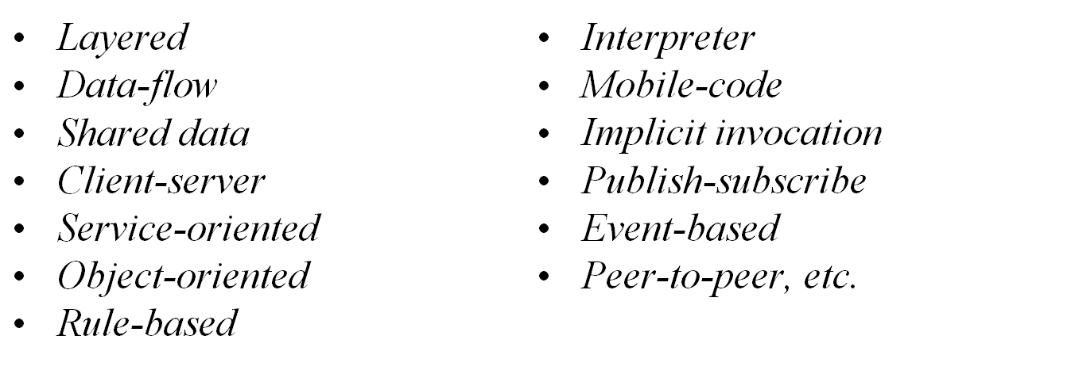
Architectural Styles (Cont’d)
Popular Architectural Styles are:

Slide 23
Architectural Styles (Cont’d)
Layered Architectural Style
Layered style of architecture is the hierarchical organization of a system in layers.
Layered systems are designed in a modular fashion at each layer in the architecture.
There are well-defined interfaces between the layers. A layer provides service to the layer above it and acts as a client to the layer below it.
Examples: Layered organization of an operating system, a database system, an object request broker (ORB), network layers, etc.

Slide 24
Figure: Layered Architectural Styles
Subsystem E
Subsystem F
Layer n
Subsystem C
Subsystem D
Layer 2
Subsystem A
Subsystem B
Layer 1
Figure: Layered architectural style

Slide 25
Benefits and drawbacks of Layered Style
Benefits:
Using the layered style, a system is designed based on the increasing level of abstraction.
The details of unnecessary implementation can be hidden at any layer.
New features can be added to a layer and new layers can be created.
The layers can be modified without affecting the layers other than the layers it’s above and below.
The layered style promotes reuse.
Drawbacks:
It is not necessary to design all systems in a layered fashion.
Adding more number of layers may decrease system performance.
Deciding the right architecture for a module is a difficult job.

Slide 26
Data-Flow Style
This style is characterized by viewing the system as a series of transformations in a successive manner.
The input data enter the system and then move through the components one at a time, and finally the transformed data are produced as output.
These architectures focus on achieving the quality of reuse and modifiability.
Earlier systems were designed using data flow architectures.
Data-flow styles can be classified as:
  Batch-sequential
  Pipe-filters architectures

Slide 27
Batch-sequential
The batch-sequential system consists of several programs which are executed in an orderly fashion.
Transfor-med data
Output data
Input data
Component
1
Component
1
Figure 6.6: Batch-sequential architectural style

Slide 28
Pipe and filters
The pipe and filter style follows the component-connector structure in which components are filters and pipes are connectors.
The filter reads stream of data as input, performs data transformation, and forwards the output data stream to another filter.
The pipe transports data streams from one filter to another filter.
In this style, system functionalities are decomposed into smaller transformations, which are performed through connectors.

Slide 29
Pipe and filters
Input data
Output data
Filter
Pipe
Figure 6.7: Pipe and filter architectural style

Slide 30
Shared Data Style
Shared data style (also known as repository style) comprised of a central data repository (or shared data such as databases, files) and a number of data accessors (like users, nodes, developers) connected to the central repository.
Shared data style creates, stores, updates, and accesses persistent data.
Data accessors access, transform, update, and restore data into the central repository.
There are two major categories of shared data styles, namely, blackboard (i.e. active repository) and traditional database (i.e. passive repository).

Slide 31
Shared Data Style
Blackboard (i.e. active repository):
  Any change or update in the repository will be notified to all the data accessors.
  For example, an insurance company policy has a central repository in which any policy change or update is informed to the customers.
Traditional database (i.e. passive repository):
  It provides permanent storage and controls the processing of the applications.
  For example, an inherent symbol table repository of a compiler is used by the phases of compilation as and when required.

Slide 32

Blackboard (i.e. active repository)
Data accessor
Central repository
Data accessor
Data accessor
Data accessor
Figure 6.8: Blackboard architectural style of shared data

Slide 33
Client-Server Style
Client-server style is useful for distributed processing, load balancing, separation of concerns, and performance analysis.
In this style, there are two types of components, viz., client and server. And there exists a connecting network between the clients and servers.
The client communicates with servers through protocol and message connectors.
Example: a web browser program running on the Internet has client server style.
The client server architectural style provides higher security, centralized data access, and easier maintenance.
The remote procedure calls (RPC) mechanism is used for requesting and providing services.

Slide 34
Client-Server Style
Server
Client 1
Client 2
Client 3
Figure 6.9: Client server style

Slide 35
Service-Oriented Architecture (SOA)
The service-oriented architecture (SOA) is an architectural paradigm that is used to provide a platform to fulfill the needs of consumers and capabilities of providers to interact through services across different domains and technology.
SOA is essentially a collection of web services, which are well defined, self-contained modules that provide standard business functionality and are independent of the state or context of other web services.
The basic SOA architecture encompasses three roles, namely, web service provider; web service consumer; and Universal Description, Discovery and Integration (UDDI) registry for handling service request, service discovery, and service invocation.

Slide 36
Service-Oriented Architecture (SOA)
UDDI registry
Find/retrieve
Register/publish
Web service consumer
Web service provider
Request/response
Figure: Service-oriented architecture

Slide 37
Other architectural styles
There are various other styles of component-connector structure, such as
  object-oriented style,
  rule-based style,
  interpreter style,
  mobile code style,
  implicit invocation style,
  event-based style,
  publish subscribe style,
  peer-to-peer style,
  communicating style,
  and so on.

Slide 38
Architectural Designs
Like other aspects of software life cycle, architectural design is also produced in an iterative manner from the requirements analysis.
Functional properties, quality attributes, and business requirements play an important role in designing the software architecture. These factors are known as architectural drivers.
The most widely used technique for designing software architecture is Architecture-Driven Design (ADD).

Slide 39
Architectural Designs (Cont’d)
The ADD process begins once the requirements analysis is over.
It takes the requirement artifacts as input, prepares the context diagram, performs decomposition, and verifies the prepared model to ensure the conformance of the architectural drivers.
The process of ADD is as follows:
  Represent the system at the context level.
  Decompose the system into subsystems and sub-modules.
    Select the architectural drivers
    Select an architectural pattern
    Instantiate the system
    Define interfaces.
    Refine and evaluate modules
  3. Repeat step 2 for each subsystem and sub-modules.

Slide 40
Documenting Software Architectures
The documentation of the software architecture includes:
Different views or structures, element catalog, context diagram, variability guide, architectural background, glossary of terms, and other related information.
The managerial aspects, such as vision, business drivers, architectural diagram, and the relationships between business strategies and technical strategies.
The structural information of different components and their interfaces

Slide 41
Documenting Software Architectures (Cont’d)
The documentation of the architectural design is used by different stakeholders in different ways:
Software architects and requirement engineers use architectural design to understand, discover, and negotiate requirements.
The project management team uses the documentation to form a team structure, task assignment, procurement of resources, resource allocation, and tracking the progress of the software.
The development team ensures the correct implementation of the project within constraints and system behavior.
The quality management team evaluates the quality parameters and checks the proper implementation of the project.

Slide 42
Evaluating Software Architectures
Software architectures are evaluated to uncover the quality attributes, control cost, and reduce budget.
Most important quality attributes such as performance, reliability, modifiability, and so on, are considered during architectural design.
The technical decisions are decided on the basis of software architectures.
Software architecture has a great impact on the cost and budget of its development and implementation.
There are various methods proposed to evaluate architectures to ensure quality and compliance to business goals.
The Architecture Trade-off Analysis Method (ATAM) is one of them.

Slide 43
Architecture Trade-off Analysis Method (ATAM) Steps
Collect scenarios : Use cases or object models, list of interfaces, signatures, and other required information are developed from the user’s point of view.
Discover requirements and constraints : This phase involves various stakeholders to collect and analyze the requirements.
Present architectural styles/patterns: The software architect describes the appropriate level of architectural structures or views.
Evaluate quality attributes: The quality attributes that the system will support are considered and interpreted in the architecture.
Identify sensitivities and tradeoff points: Identify the effects and tradeoffs due to changes in system.
Analyze the influences for candidate architecture: After analyzing the architecture and based on above results the team of architectural design decides whether the existing architecture should be changed or new architecture should be proposed.

Slide 44
Design Methodologies
A design methodology provides the techniques and guidelines for the design process of a system.
The goal of all design methodologies is to produce a design for the solution of a system.
A design process consists of various design activities.
The most popular design methodologies are:
  Function-oriented design
  Object-oriented design

Slide 45
Function-oriented design
Function-oriented design is a mature design methodology for software design. It begins with the requirements document, i.e., SRS to understand different modules.
It follows the top-down design strategy in which focus is initially given on the global perspectives (main file, global data, records, external interaction, etc.) of the overall system.
Thereafter, the system is decomposed into subsystems using the top-down strategy.
The subsystems are again refined into more detailed functional levels.
Decomposition is continued until we reach the concrete level.
The concrete level states are easy to convert into programming languages.

Slide 46
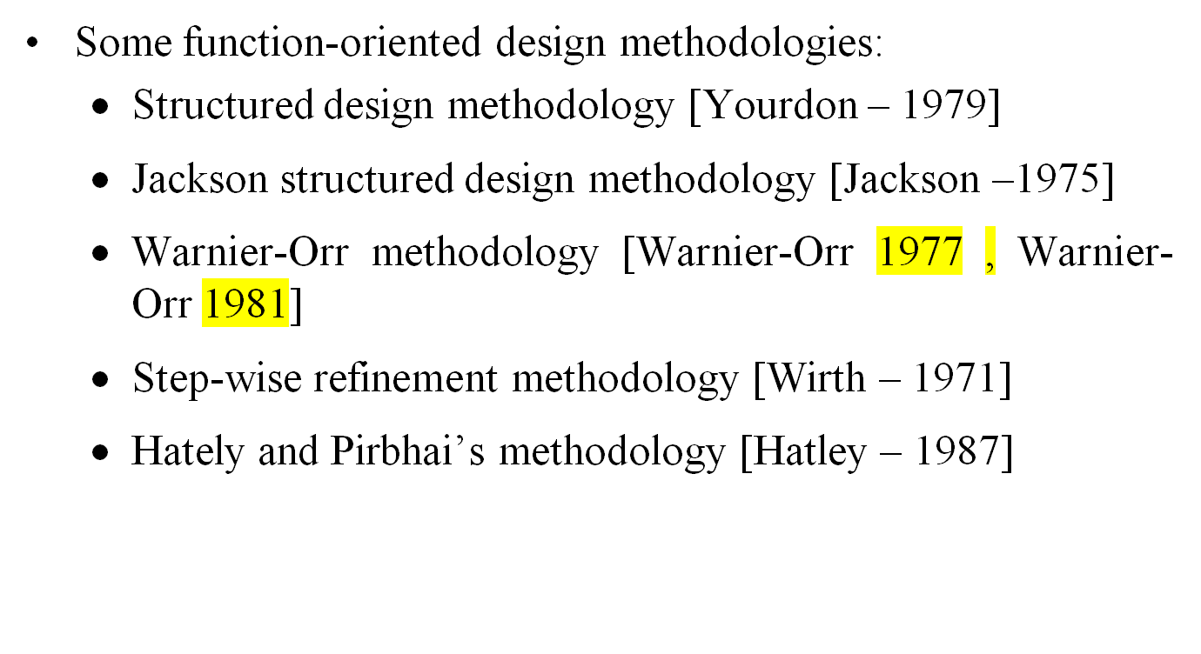
Function-oriented design (Cont’d)

Slide 47
Object-Oriented Design
Object- oriented design deals with the real world entities of the environment for problem solving.
The entities are characterized by objects.
Similar objects are combined into a group called a class.
A class contains data and its related functions that it will perform.
The object-oriented approach follows the bottom-up strategy for design.

Slide 48
Object-Oriented Design (Cont’d)
Object-oriented design methodologies:
  Shlaer/Mellor methodology [Shlaer – 1988]
  Coad/Yourdon methodology [Coad – 1991]
  Booch methodology [Booch – 1991]
  OMT methodology [Rumbaugh – 1991]
  Wirfs-Brock methodology [Wirfs-Brock – 1990]
  OOSE objectory methodology [Jacobson – 1992]
  UML (Unified Modeling Language) [Rational – 1997]

Slide 49
Structured Design
Structural design is one of the most widely used function-oriented design methodology which follows mainly the top-down design strategy .
The basic approach of structured design is to transform the data flow diagrams of structural analysis into structure charts.
Structured design is represented through the structure chart and it follows the transform analysis and transaction analysis to produce the design of the system.
It is based on functional decomposition, which concentrates on identifying the conceptual view of the system and its elaboration and refinement in a top-down manner.
The modularization criteria (i.e. coupling and cohesion) are used to represent the design decisions.

Slide 50
Structure Chart
The structure chart is a graphical representation of procedural programs in the structured design methodology.
It represents the modules of a system in a hierarchical fashion.
It shows the dependency between the modules and the parameters that are passed among the different modules.
It produces a software structure that can be easily implemented in programming languages.
The building blocks in the software are represented through modules and these are linked together to produce the final design.

Slide 51
Structure Chart (Cont’d)
Symbols used to represent the structure chart:
Affluent module: The affluent module, also known as the input module, receives information from a subordinate module and passes to a superordinate module. This module is used to collect the input data.
Efferent module: The efferent module, also known as the output module, passes information from a superordinate to a subordinate module. This module is used to produce intermediate or final outcomes.
Transform module: The transform module performs data transformation. It receives data, performs some operations, and represents them into another form.
Coordinate module: The coordinate module manages the transformations communication between subordinate modules.

Slide 52
Structure Chart (Cont’d)
Composite module: The composite module can perform functions at more than one module.
Selection: The selection of a module is represented through a diamond box. The control couple decides which subordinate module is to be invoked for further operation.
Repetition: The repetition of a module is represented by a looping arrow around the modules to be iterated in the program.
Library module: The library module is represented by a rectangle with double edges. The frequently called modules are iterated in the design.

Slide 53
Structure Chart (Cont’d)
Module A
Coordinate module
Composite module
Module A
Module B
Module C
Affluent module
Efferent module
Library module
Selection module
Repetitive module
Module A
Module A
Module A
Module B
Module B
Module C
Module B
Module C
Transform module
Figure 6.11: Types of modules

Slide 54

An example of structure chart
Download
manager
URL
File
URL
File
Initialize
URL
Downloading
Storage
URL
URL
File
File
File
URL
File
Status
Download list
Pause download
Cancel download
Download status
Delete download
File
File
Flag
Get file name
Check existence
Resume download
Figure 6.12: Structure chart for the download manager

Slide 55
Structure Chart versus Flowchart
Although flowcharts and structure charts are used for problem solving of procedural programs, both are different in the representation of their designs layouts.
The structure chart shows the task to be performed by the program, whereas a flowchart shows how the program will perform the task.
Also, a flowchart does not state the algorithmic details of the system.
In a structure chart, modules may be implemented separately, which can be modified in the later stages, while a flowchart represents a single snapshot of the problem and its flow of information.
Therefore, it becomes difficult to identify and separate program execution in modules.

Slide 56
Structured Design Methodology
The structured design methodology (SDM) is a systematic approach for decomposing and organizing different modules in a structure chart.
The SDM uses data flow diagrams constructed during structured analysis to perform structured design.
There are two important strategies used for transforming data into the structure charts:
  Transform analysis
  Transaction analysis

Slide 57
Structured Design Methodology (Cont’d)
Transform analysis:
Transform analysis is applicable in the situations where there is a single path of any transformation, i.e., all input data are incoming to the transform module.
It is applicable for small functional problems such as computational, scientific, and engineering computations.
Transaction analysis
It is used when there are multiple paths emerging at any moment. During transaction analysis, transform analysis can be applied in individual modules for refinements.

Slide 58
Structured Design Methodology (Cont’d)
The structured design methodology using transform analysis is as follows:
  Review and refine the data flow diagram.
  Identify boundaries between input, process, and output segments.
  Apply first-level factoring using design principles and modularization criteria.
  Perform additional factoring on input, process, and output segments.

Slide 59
Structured Design Methodology (Cont’d)
Review and Refine Data Flow Diagram
This DFD is drawn to understand the problem domain. It covers the external environment and the flow of data in the existing system.
A functional DFD is extracted from the existing DFD by refining it to hold into transformational form.
The important functions with its major input and output segments are considered in it.
The input and output segments have several subparts inherent in them.
The functional part is also known as central transform. Central transform exists between inputs and outputs.

Slide 60
Structured Design Methodology (Cont’d)
Review and Refine Data Flow Diagram
Perform calculation
Get
exp
Produce result
exp
cvalue
Input
Output
Figure 6.13: Functional DFD for a simple calculator

Slide 61
Structured Design Methodology (Cont’d)
2. Identify Boundaries between Input, Process, and Output Segments
The boundary between input stream, central transform, and output stream is marked by identifying the most abstract input data and the most abstract output data.
The most abstract input in a DFD is the input stream that can no longer be identified.
Similarly most abstract output is the first output stream identified in the DFD.
The control which performs the basic transformation for the system exists between the most abstract input and the most abstract output.
The boundary is drawn as arcs between the most abstract input and central transform; and central transform and the most abstract output.

Slide 62
Structured Design Methodology (Cont’d)
2. Identify Boundaries between Input, Process, and Output Segments
Perform calculation
Get
exp
Produce result
exp
cvalue
Input
Output
Input boundary
Output boundary
Figure 6.14: Boundaries between input, process, and output segments for a simple calculator

Slide 63
Structured Design Methodology (Cont’d)
3. Apply First-Level Factoring using Design Principles and Modularization Criteria
First-level factoring is performed after identifying the most abstract input and the most abstract output
Central transform is connected to the main module and it is considered a coordinate module between the input and output data streams.
The input and output modules become the subordinate modules to the main module.
There may be many transform, input, and output modules in the system.

Slide 64
Structured Design Methodology (Cont’d)
3. Apply First-Level Factoring using Design Principles and Modularization Criteria
Main
exp
cvalue
exp
cvalue
Get exp
Perform calculation
Produce result
Figure 6.15: First-level factoring for a simple calculator

Slide 65
Structured Design Methodology (Cont’d)
Perform Additional Factoring on Input, Output, and Transform Module
Additional factoring is done on each input module, central transform, and output module depending upon the complexity and size of the modules.
Factoring of modules is continued until we reach the modules that are corresponding to the source or data stores, or until it becomes sufficient to transfer them to the implementation level.
Factoring is performed using all the design principles such as abstraction, functional decomposition, modularity, information hiding, etc.
Finally, other modules such as error handling, security, backup etc., are added to the modules wherever they are required in the design.

Slide 66
Structured Design Methodology (Cont’d)
Perform Additional Factoring on Input, Output, and Transform Module
Perform calculation
exp
cvalue
exp
cvalue
cvalue
exp
Arithmetic
Logarithmic
Trigonometric
(a)
Get exp
Produce result
Input value
exp
Result
Input value
cvalue
Result
Get input
Verify exp
Verify
result
Print
(b)
(c)
Figure 6.16: Additional factoring of central transform and input and output modules

Slide 67
Transaction Analysis
Transaction analysis is similar to transform analysis but there may be several paths from any transaction in the DFD.
The action of each path is dependent on the input command.
T
Transaction centre
Figure: Transaction analysis

Slide 68
Transaction Analysis
Account management
Open
account
Balance enquiry
Deposit amount
Withdraw money
Close account
Figure 6.18: Transaction operations on account management module

Slide 69
Detailed Design
Detailed design concentrates on specifying the procedural descriptions, data structure representation, interfaces between data structures and functions, and packaging of the software product.
Detailed design of a system is closer to its implementation.
Detailed design helps to specify implementation decisions such as procedural details, data structure, interfaces, packaging information etc.
Detailed design tools: Algorithm, pseudo code, PDL, HIPO diagram, structured English, data structure diagrams, structured flow charts, and so on.

Slide 70
Program Design Language (PDL)
Program Design Language (PDL) is a software design tool which is used to produce structured design in a top-down manner.
PDL generates pidgin language that is similar to structured English.
PDL covers all important requirements required during implementation. These are the procedures, procedure calls, global data, control blocks, interface definitions, error situations, processing procedures of PDL programs, etc.
The most common constructs used in PDL are IF-THEN-ELSE, DO, DO-WHILE, DO-UNTIL, DO-FOR-EXCEPT, and CASE-OF.
PDL programs can be used to produce source codes of programming languages through PDL procedures.

Slide 71
Program Design Language (PDL) (Cont’d)
SUM (ARRAY A, N)
  Initialize total to 0
  DO FOR N input
  read a number into A
  ENDDO
  DO WHILE there are numbers in A
  add number to total
  print (total)
END
Figure: PDL program for finding the sum of n numbers

Slide 72
Algorithmic Design
An algorithm is a step-by-step process of problem solving.
n algorithm has two parts, namely, problem definition and design of algorithm.
Problem definition states the problem to be solved by the algorithm.
The design of algorithm is the sequence of steps performed to solve the problem.
An algorithm is written in a formal statements or pseudo code.
The design of an algorithm is done through step-wise refinement, in which algorithm is broken down into smaller parts so that it can be solved in a convenient and manageable manner.

Slide 73
Figure 6.20: An algorithm for binary search
Algorithm Binary_Search (A, N, X). This algorithm searches the element X from in an array A of N elements arranged in an ascending order. The variables Low, Mid, and High represent the lower, middle, and upper limits of the search interval, respectively. This algorithm prints the middle element in case of successful search, otherwise it prints unsuccessful search.
  . [Initialize]
  Low = 1, High = N
  . [Perform search]
Repeat thru step 4 while Low<=High
  . [Find the middle element]
  Mid = [(Low + High)/2]
  . [Compare]
  If X < A[Mid]
  then High= Mid-1
  else If X > A[Mid]
  then Low = Mid + 1
  else Write (’Successful search’)
  Write (Mid)
  . [Unsuccessful search]
  Write (‘Unsuccessful search’)
  Write (‘Element not found’)

Slide 74
Design Verification
Design verification ensures that all the requirements have been incorporated in the design, modules and their interfaces are accurately specified, and there is a systematic flow of information among modules.
A good design can easily be modified and maintained in the future. Also a systematic design can be easily converted into the programming languages.
Two most common approaches used for design verification are design reviews and design inspections.

Slide 75
Case Study: Library Information System
Problem Description
  Users point of view:
    Three types of users are there
      Borrowers (perform transactions with the system)
      Library Management Personnel (who responsible for providing service, maintenance, administration, ... etc.). Further they can be divided into two types
        Library Assistants (support to the Borrowers for their transactions )
        Library Managers (responsible for overall maintenance and management of the library)
      Suppliers (who supply books, response to quotations etc.)
Information System Design

Slide 76
Case Study: Library Information System
Problem Description
  Functional point of view:
    Privileged services for the Borrowers
      Get registration
      Membership renew
      Search book
      Renew book
      Reserve book
    Privileged services for the Library Assistants
      Issue and renew book to a borrower
      Return a book by a borrower
      Validate new registration
      Validate renew of membership
      Delete a membership
Information System Design

Slide 77
Case Study: Library Information System
Problem Description
  Functional point of view:
    Privileged service for the Library Manager
      Enter a New book
      Remove a book
      Billing System
        Get membership fee
        Get renewal fee
        Get fine/recovery charge
        Payment to a supplier
      Status of books
        Total number of books in the text book section
        Total number of books in the reference section
        Number of books lost etc.
Information System Design

Slide 78
Case Study: Library Information System
Problem Description
  Functional point of view:
    Privileged services for the Library Manager
      Miscellaneous queries
        Total number of books for a given subject
        How many books for a given title?
        How many books for a given author?
        Total deposit on membership
        Total earn on fine/recovery
    Privileged services for the Suppliers
        Books on demand
        Authorization request
        Response to quotation
        Submit bill
        Get payment etc.
Information System Design

Slide 79
Case Study: Library Information System
Problem Description
  Information point of view:
    List of books
    List of borrowers
    List of library personnel and their authorizations
    List of all suppliers and supplies
Information System Design

Slide 80
Function-Oriented Design
Information System Design

Slide 81
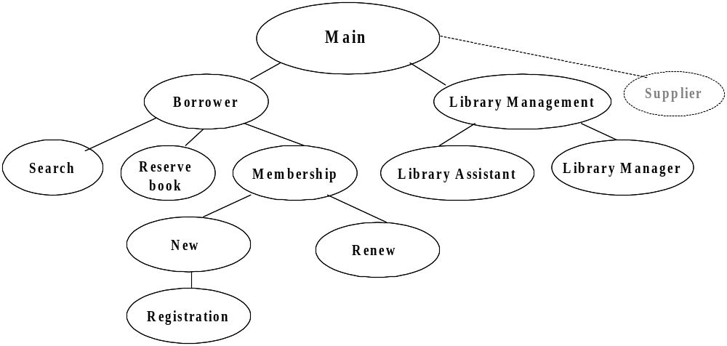
Function-Oriented Design of LIS
Structural View
Information System Design

Slide 82
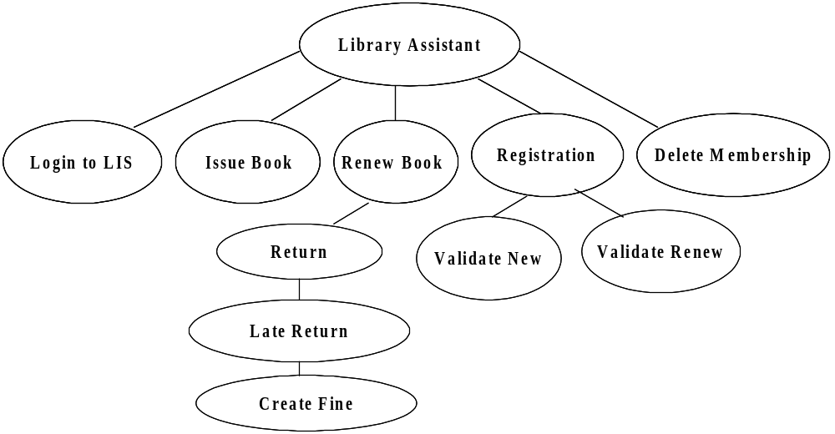
Function-Oriented Design of LIS
Structural View (cont’d)
Information System Design

Slide 83
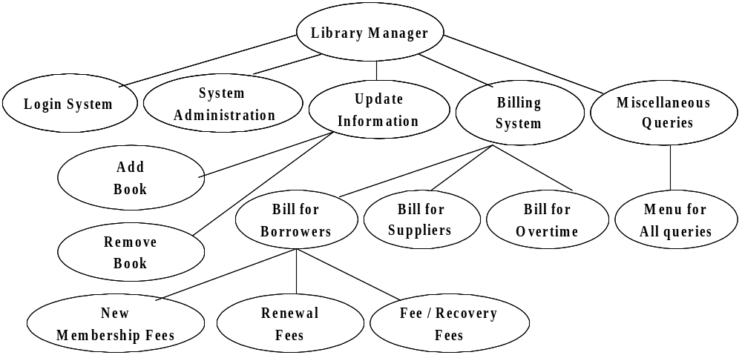
Function-Oriented Design of LIS
Structural View (cont’d)
Information System Design

Slide 84
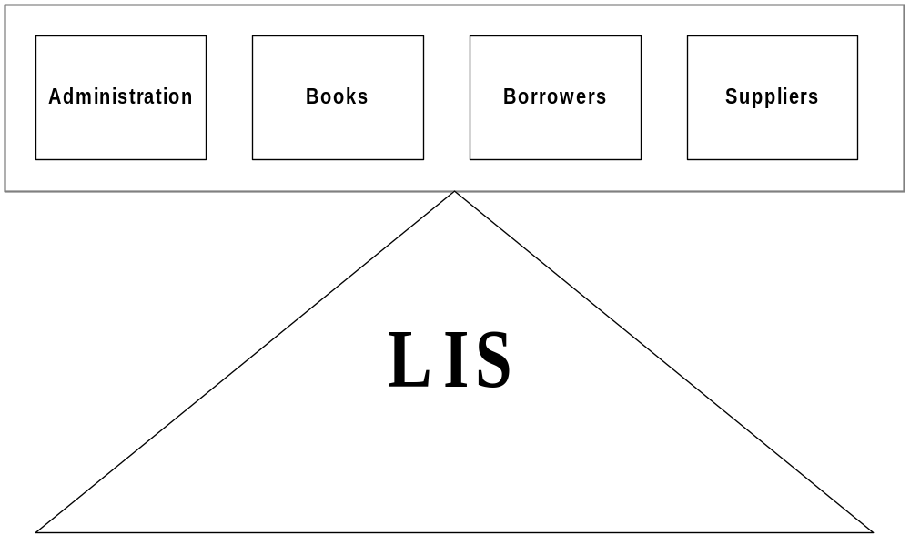
Function-Oriented Design of LIS
System View (cont’d)
Points to be noted
Data is centralized
Several functions are there to manipulate centralized data
Functions are grouped together to form high level functions
Information System Design

Slide 85
Object-Oriented Design
Information System Design

Slide 86
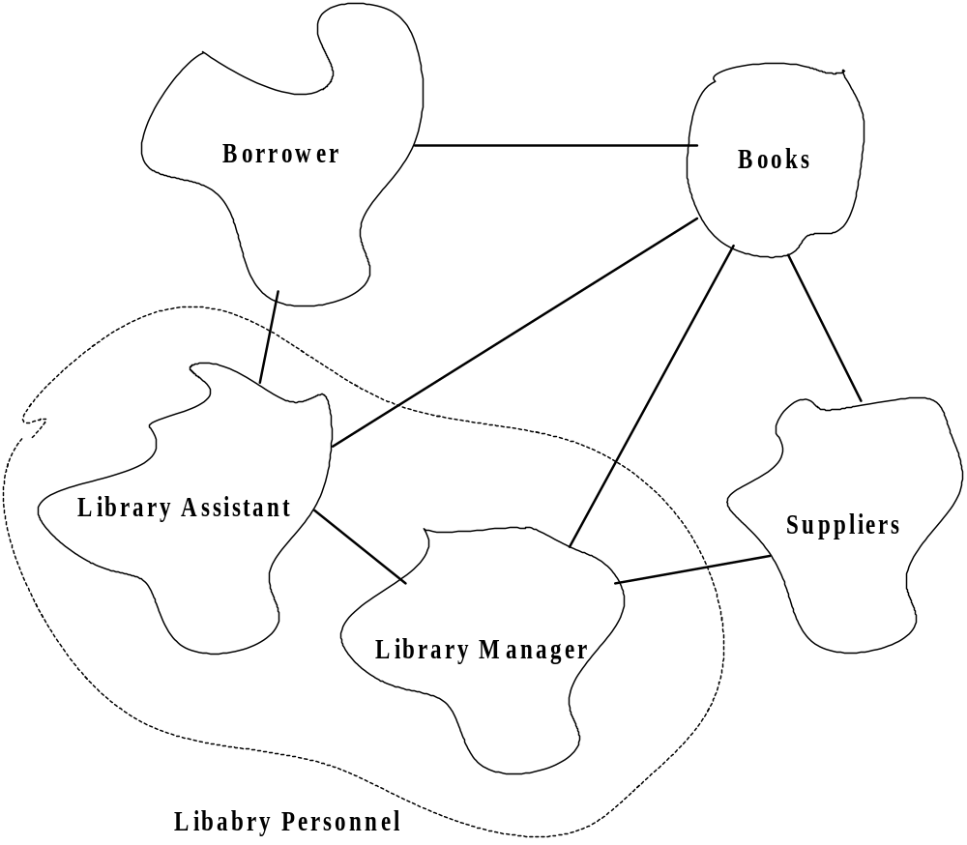
Object-Oriented Design of LIS
Structural View
Information System Design

Slide 87
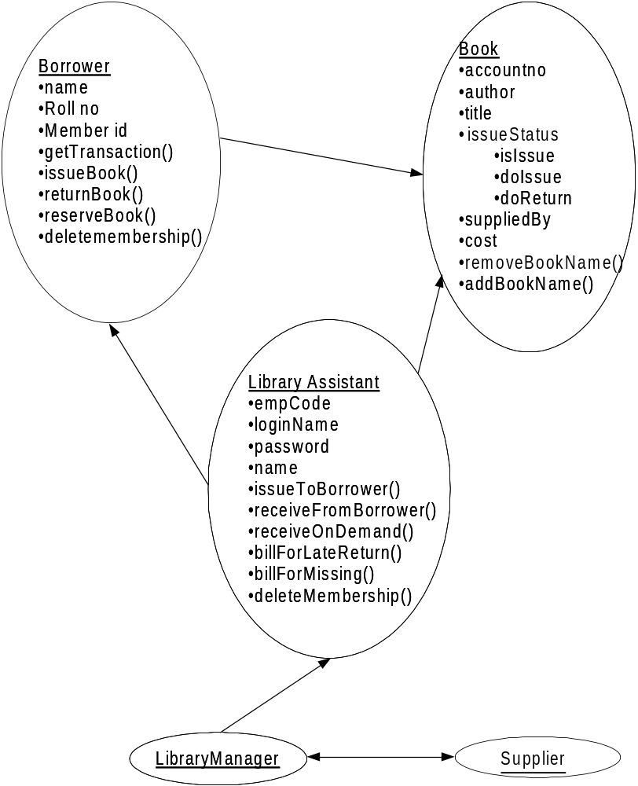
Object-Oriented Design of LIS
Structural View (cont’d)
Information System Design

Slide 88
Object-Oriented Design of LIS
System is designed by designing objects
Objects are abstractions of real-world or system entities and manage themselves
Each object has attributes, operations
Information is not represented as a centralized store
Data and operations are grouped together
Information System Design

Slide 89
Exercises
Use the structured design methodology to produce a design for the following :
  A system to convert ASCII to EBSDIC?
  A system that acts as a calculator with only basic arithmetic functions?
  A system do do student registration in the manner it is done at your college?
  A system to manage the inventory at a hardware store?
What is the basic principle of decomposing an object?
Compare function-oriented approach and object-oriented approach
  Decide parameters for comparison
Information System Design

